Slide 1
Penetration Testing Tools
Lecturer: Ngo Huy Bien
Software Engineering Department
Faculty of Information Technology
VNUHCM - University of Science
Ho Chi Minh City, Vietnam
nhbien@fit.hcmus.edu.vn

Slide 2

Objectives

Slide 3

Contents

Slide 4

References

Slide 5
Burp Suite
https://portswigger.net/burp/communitydownload

Slide 6
Snyk
https://snyk.io/

Slide 7
Zed Attack Proxy (ZAP)
https://www.zaproxy.org/

Slide 8


Slide 9
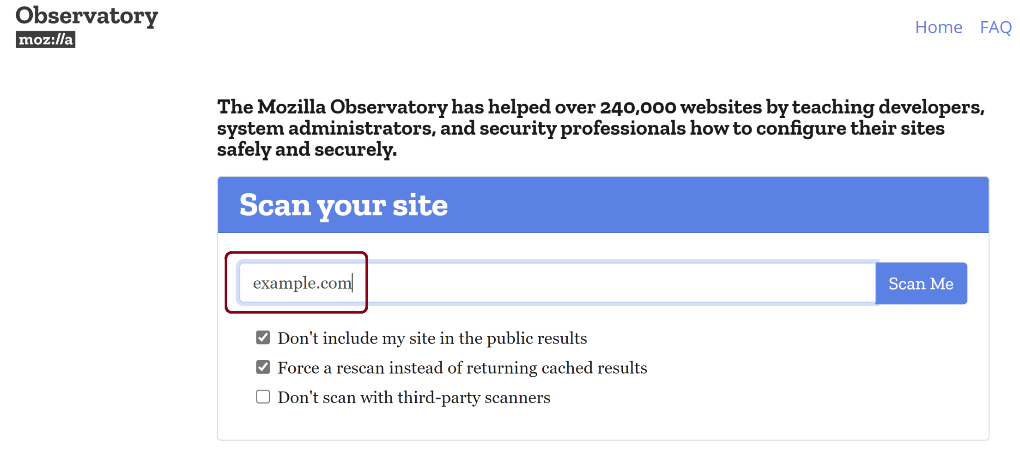
1. Scan a Domain
https://observatory.mozilla.org/

Slide 10
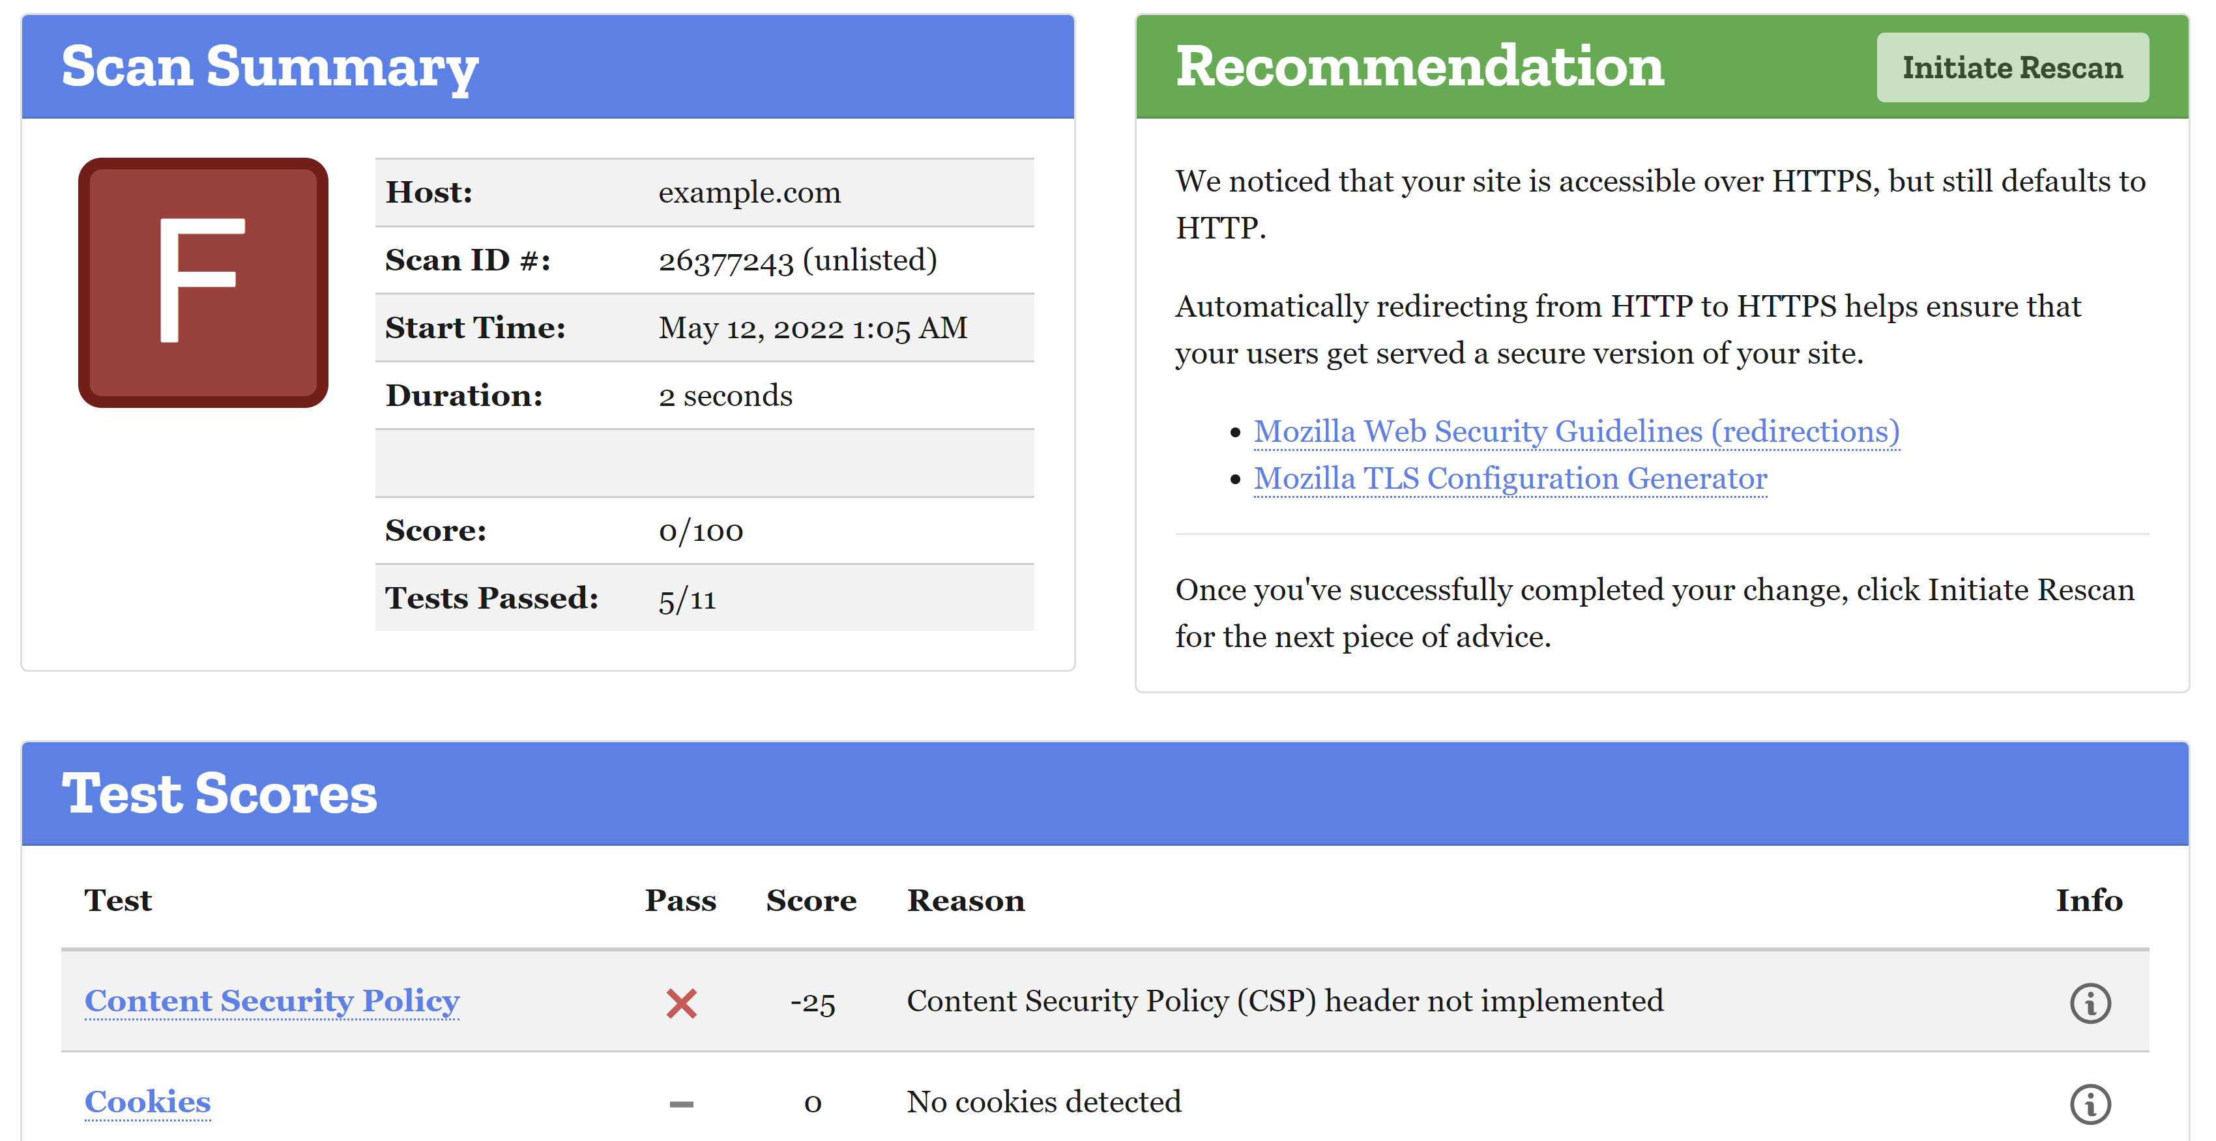
2. Review the Result

Slide 12
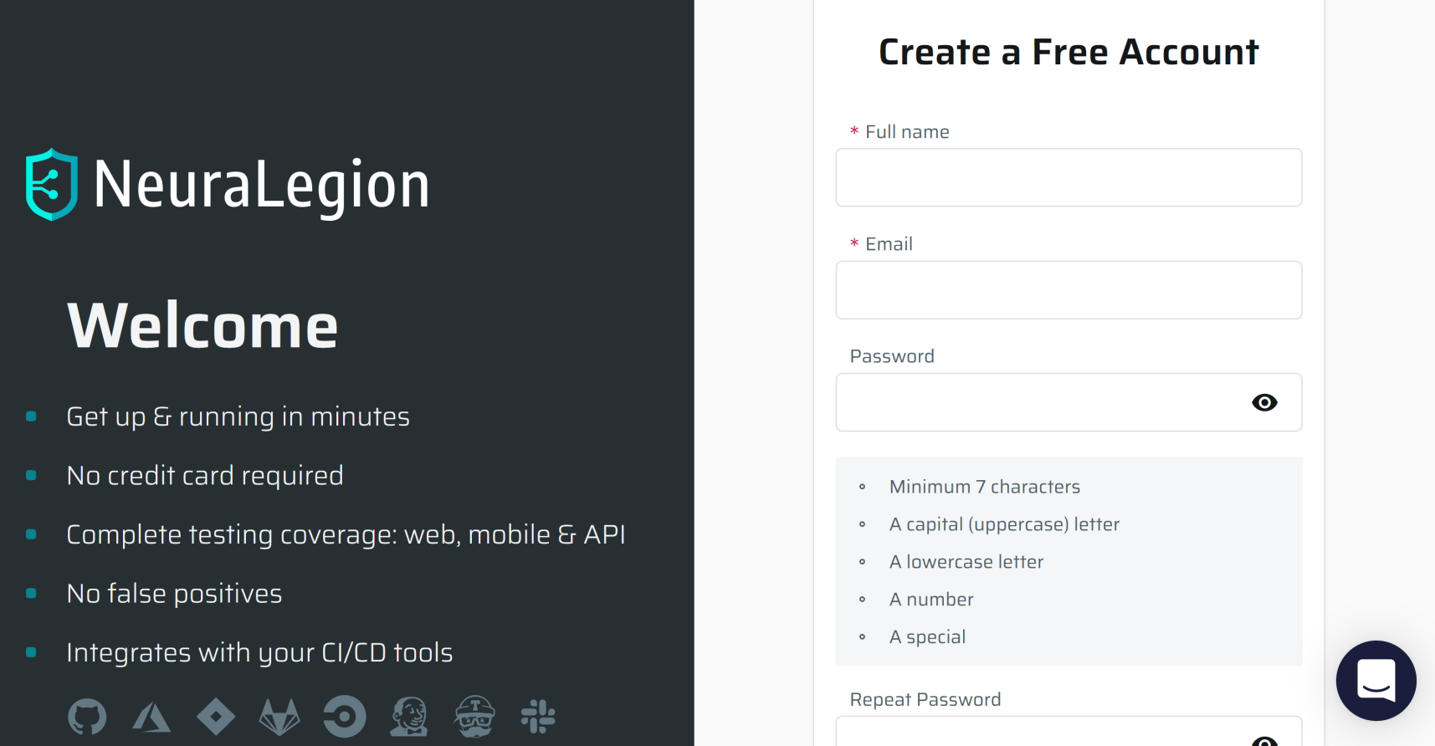
1. Register NeuraLegion Account
https://app.neuralegion.com/signup

Slide 13
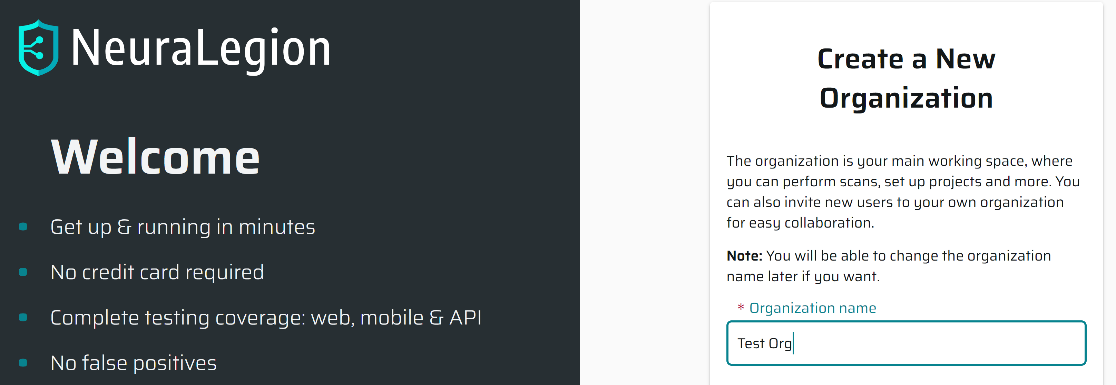
2. Create a New Organization

Slide 14
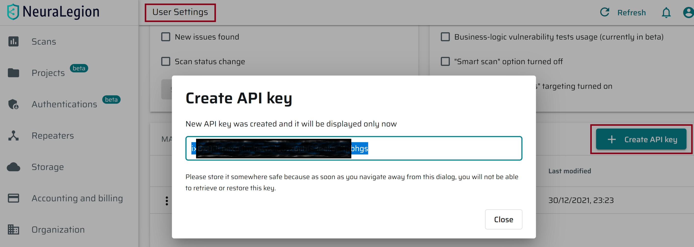
3. Create NeuraLegion API Key
User Settings > Manage your User API keys

Slide 15
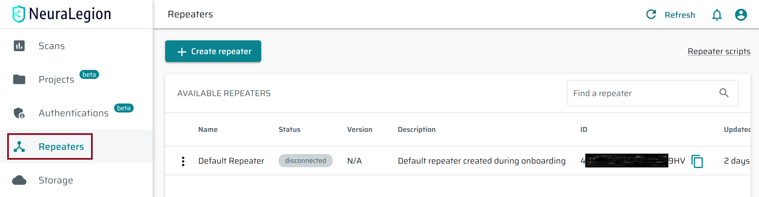
4. Retrieve NeuraLegion Repeater ID

Slide 16
5. Install Node.js 16.14.2
https://nodejs.org/en/

Slide 17
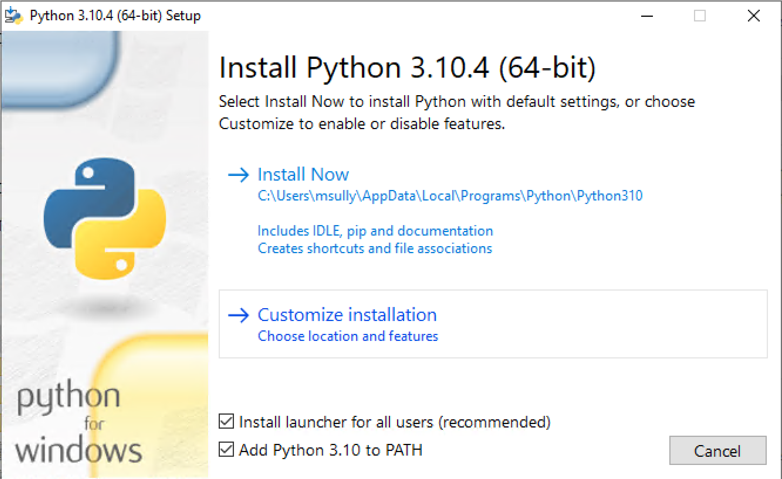
6. Install Python 3.10.4
https://www.python.org/downloads/

Slide 18
7. Install Neuralegion CLI
npm install -g @neuralegion/nexploit-cli
nexploit-cli --version
ISSUE!!!

Slide 19
8. Start a Repeater
https://www.npmjs.com/package/@neuralegion/nexploit-cli
nexploit-cli repeater --token ix0x00l.nexp.itmhswlelyovzyjibfs3eekej21pbhgs --id 4ofnsRvqvU7Ji5EdETa9HV --bus amqps://amq.app.neuralegion.com:5672

Slide 21
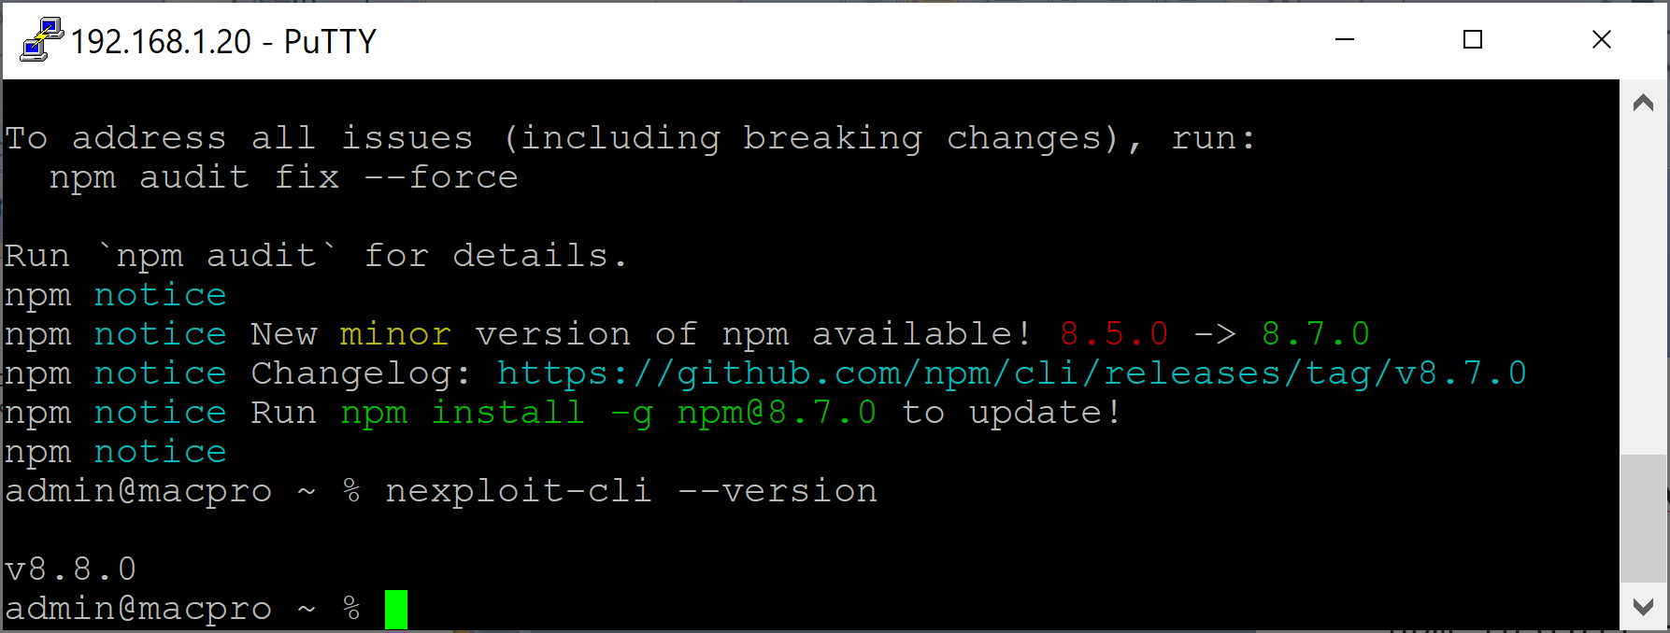
1. Install Neuralegion CLI in macOS
npm install -g @neuralegion/nexploit-cli
nexploit-cli --version

Slide 22
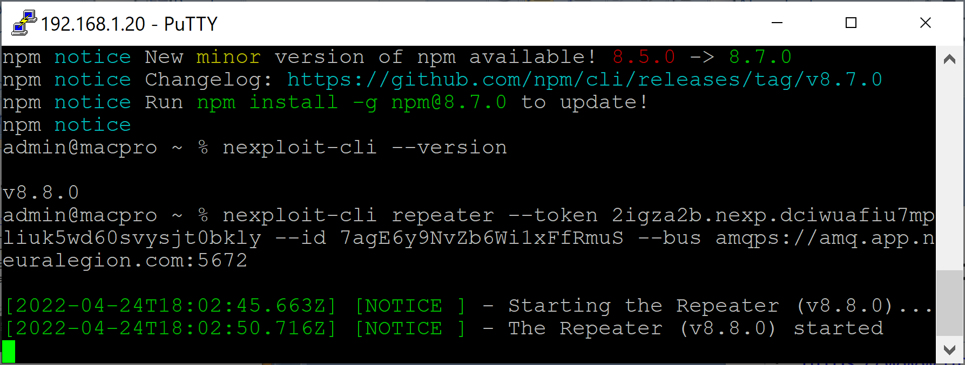
2. Start a Repeater in macOS
https://www.npmjs.com/package/@neuralegion/nexploit-cli
nexploit-cli repeater --token 2igza2b.nexp.dciwuafiu7mpliuk5wd60svysjt0bkly --id 7agE6y9NvZb6Wi1xFfRmuS --bus amqps://amq.app.neuralegion.com:5672

Slide 24
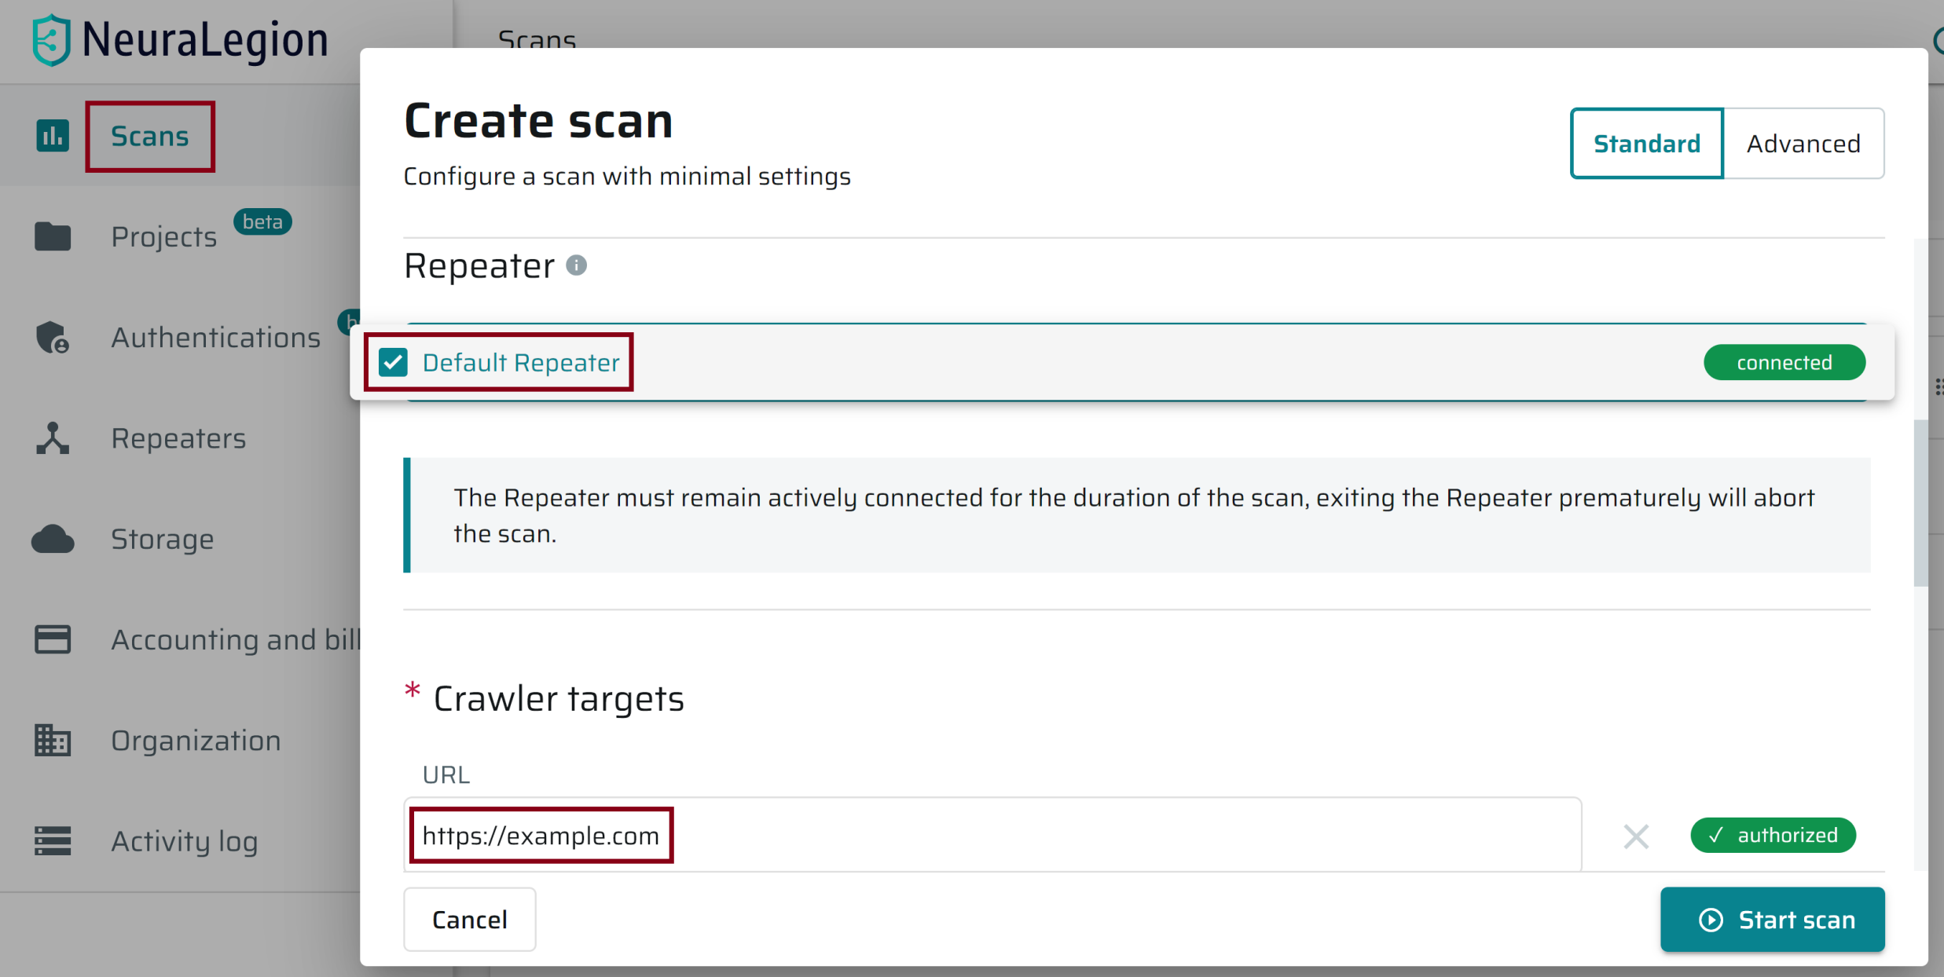
1. Scan a Website

Slide 25
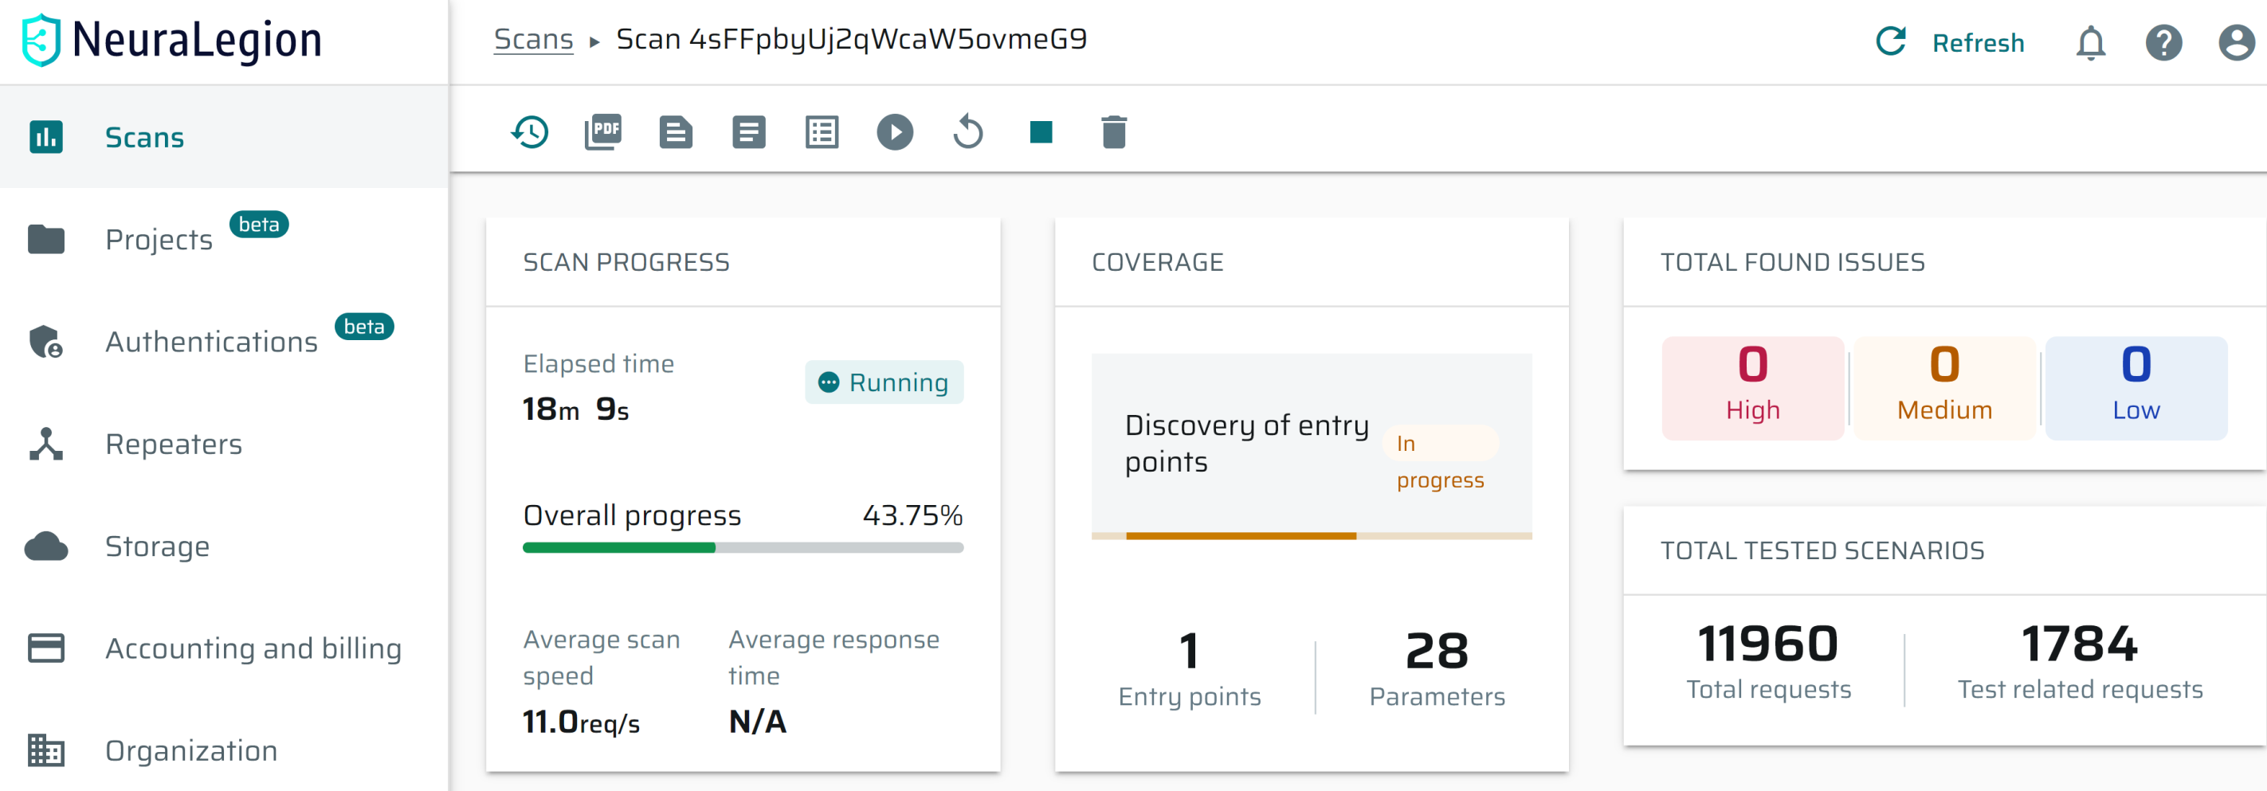
2. Review Scan Progress

Slide 26
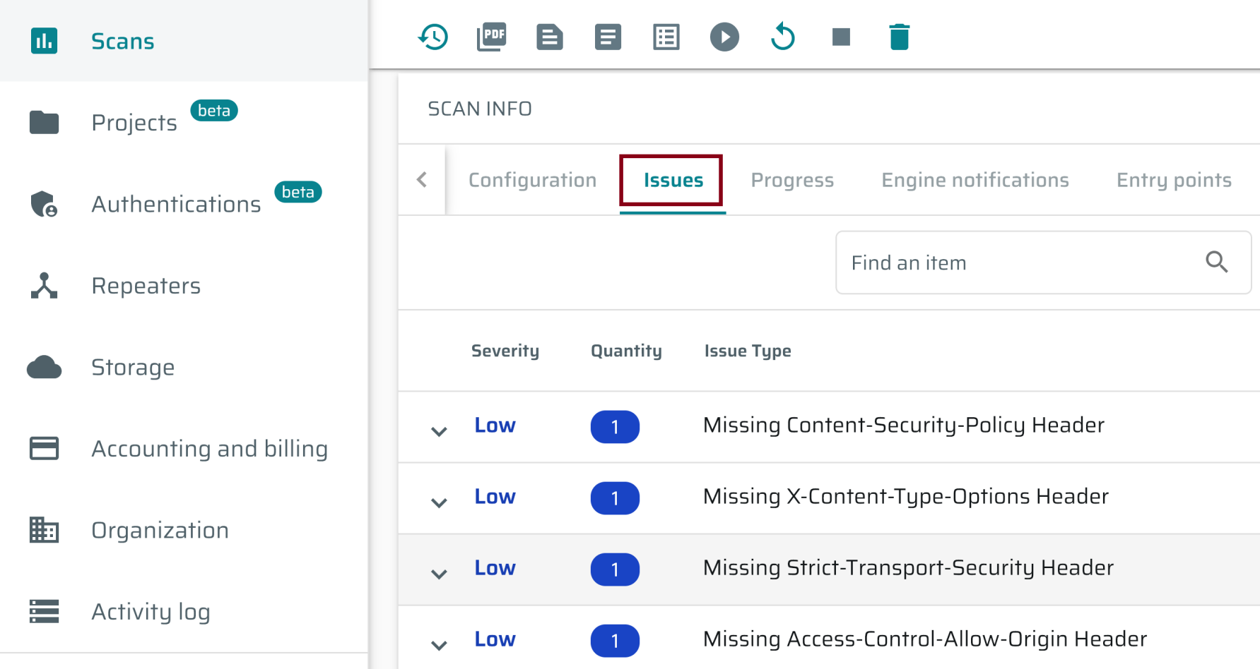
3. Review Issues

Slide 28
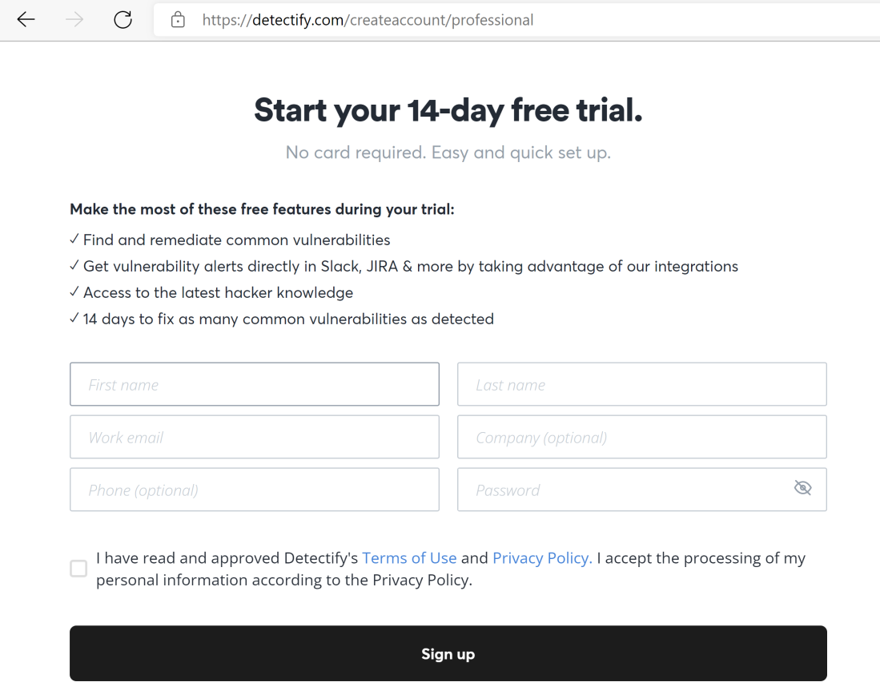
1. Register detectify.com Account
https://detectify.com/createaccount/professional

Slide 29
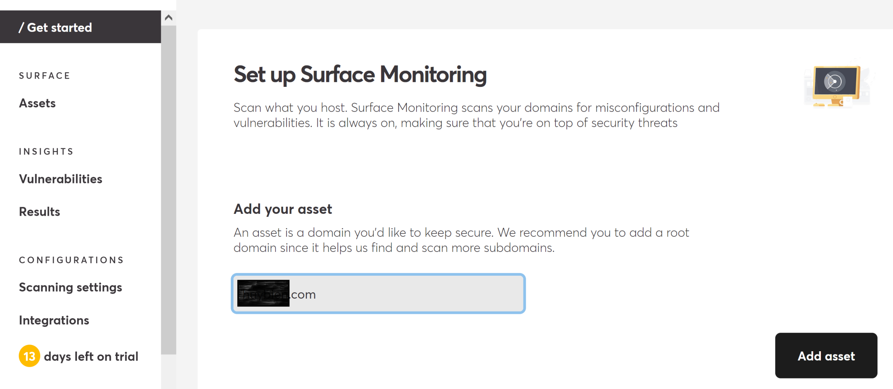
2. Add your asset

Slide 30
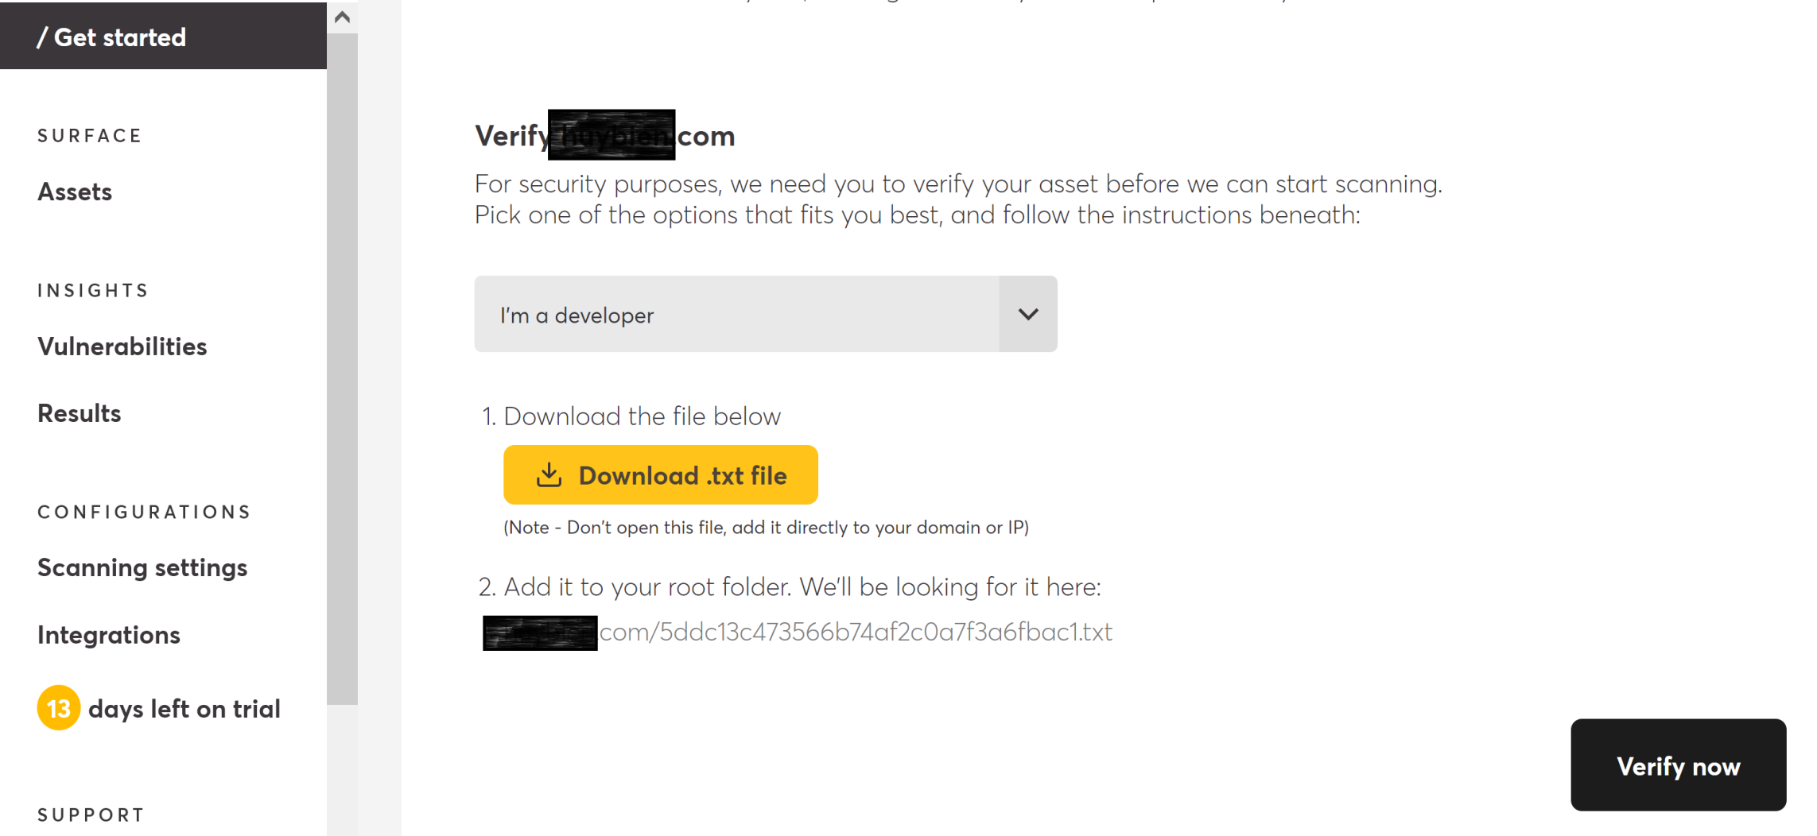
3. Verify your asset
Rename the downloaded file to the .txt file extension if your browser removes its extension.

Slide 31
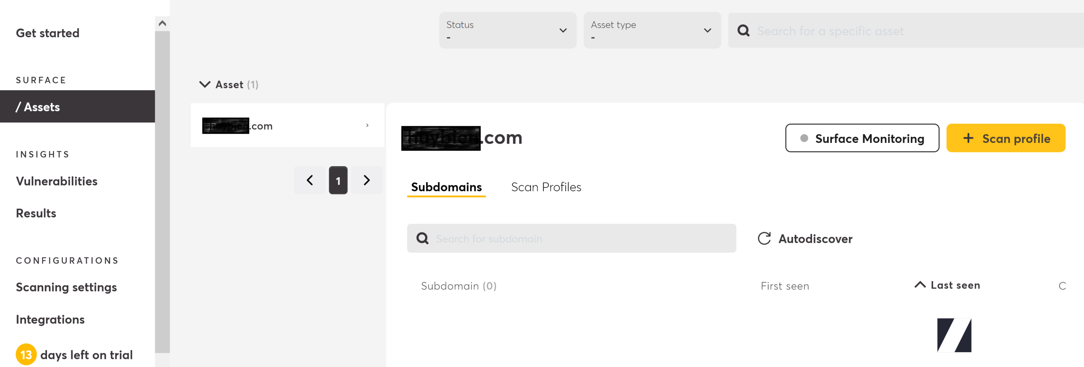
4. Create Application Scan Profile (I)

Slide 32
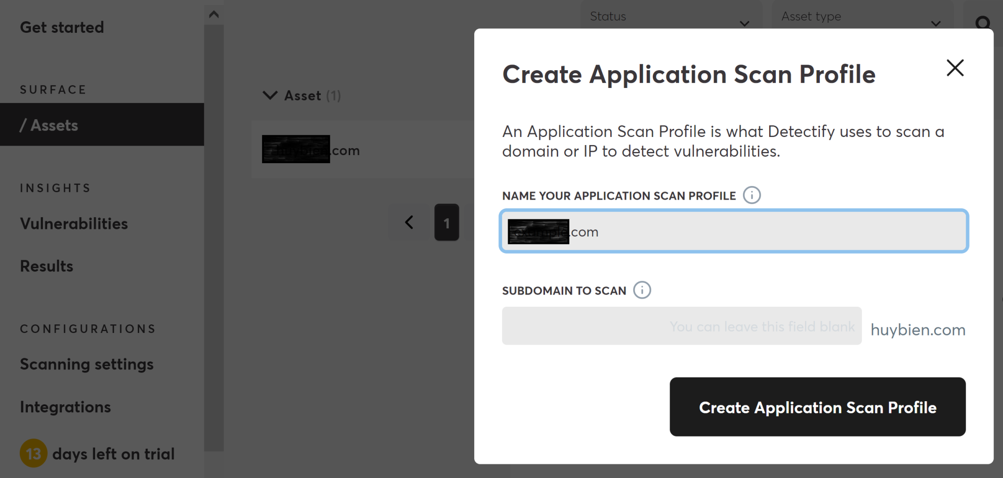
4. Create Application Scan Profile (II)

Slide 33
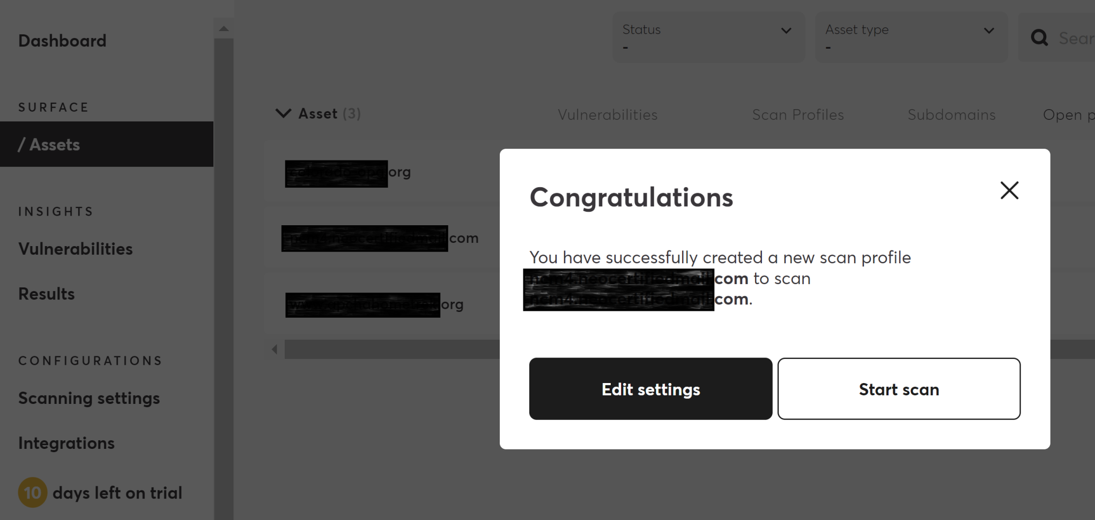
5. Start a Scan

Slide 34
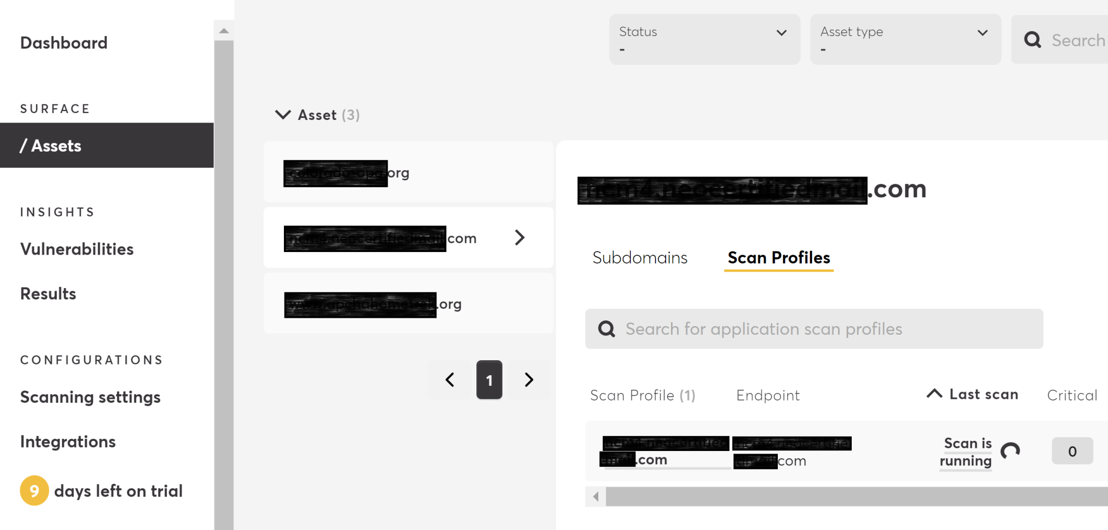
6. Review Scanning Progress

Slide 35
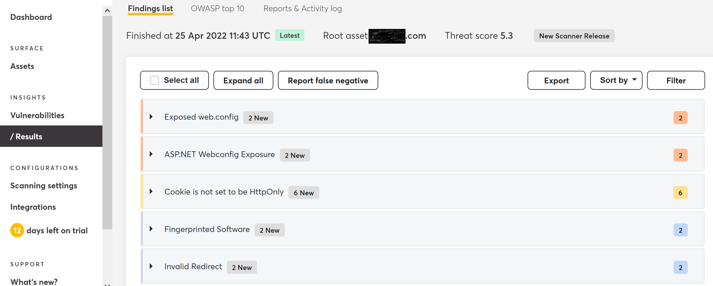
7. Review the Scan Result

Slide 36
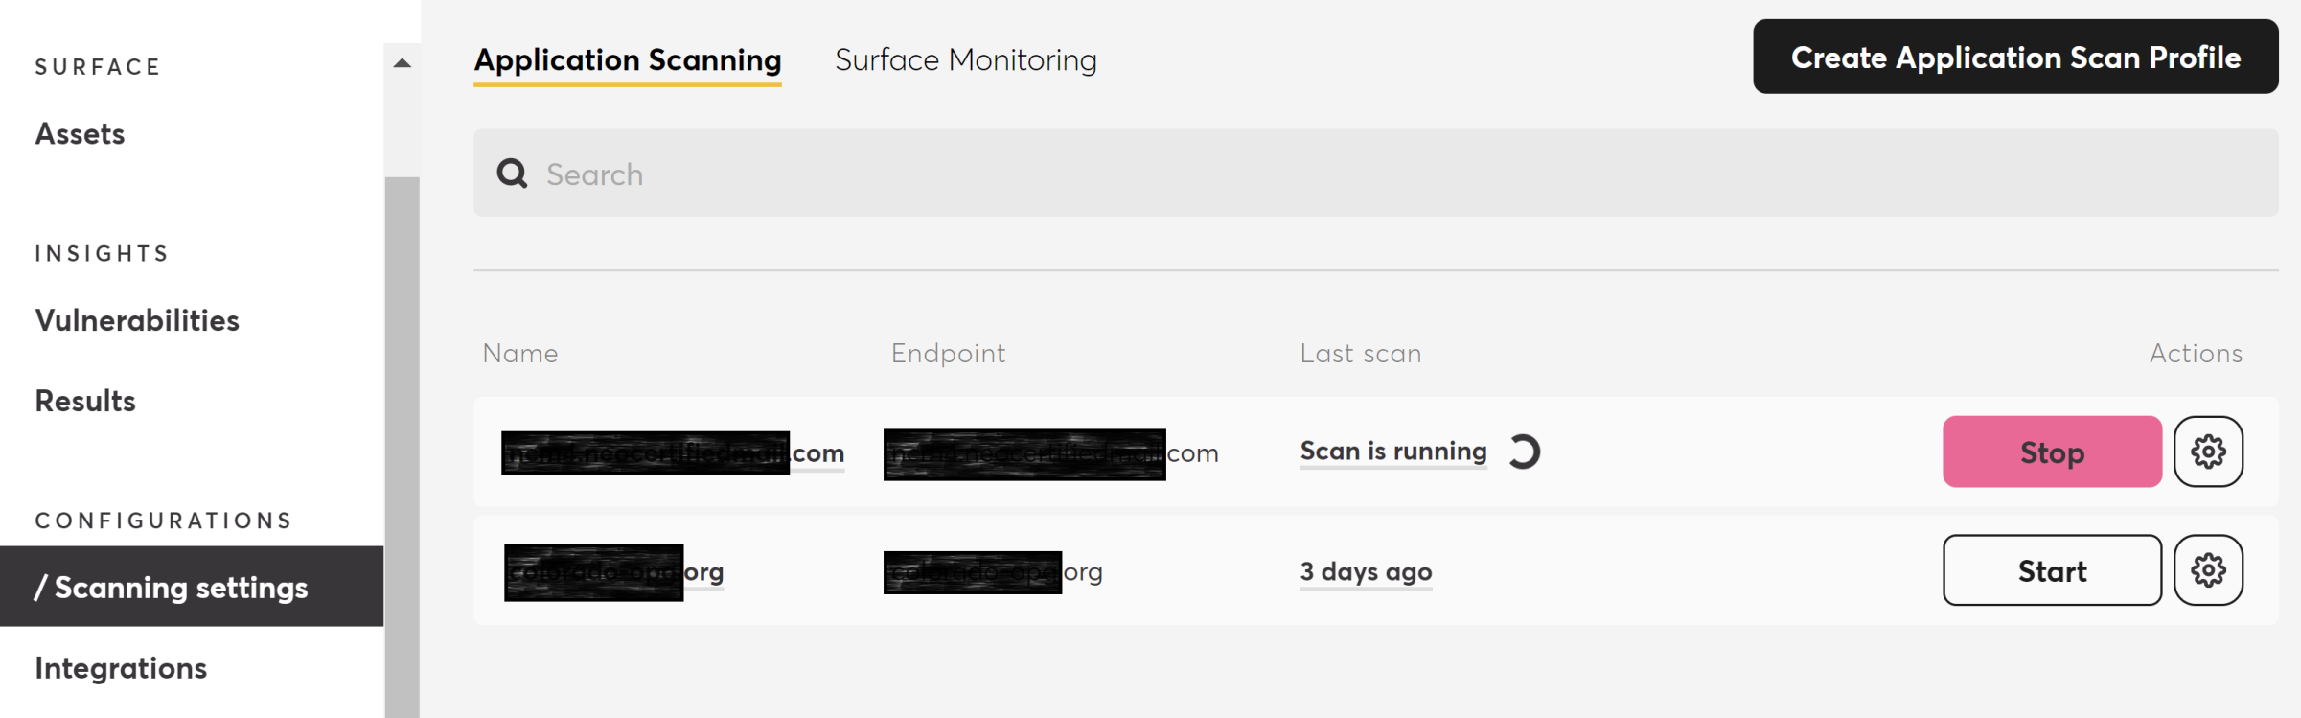
8. Rescan a Website

Slide 37
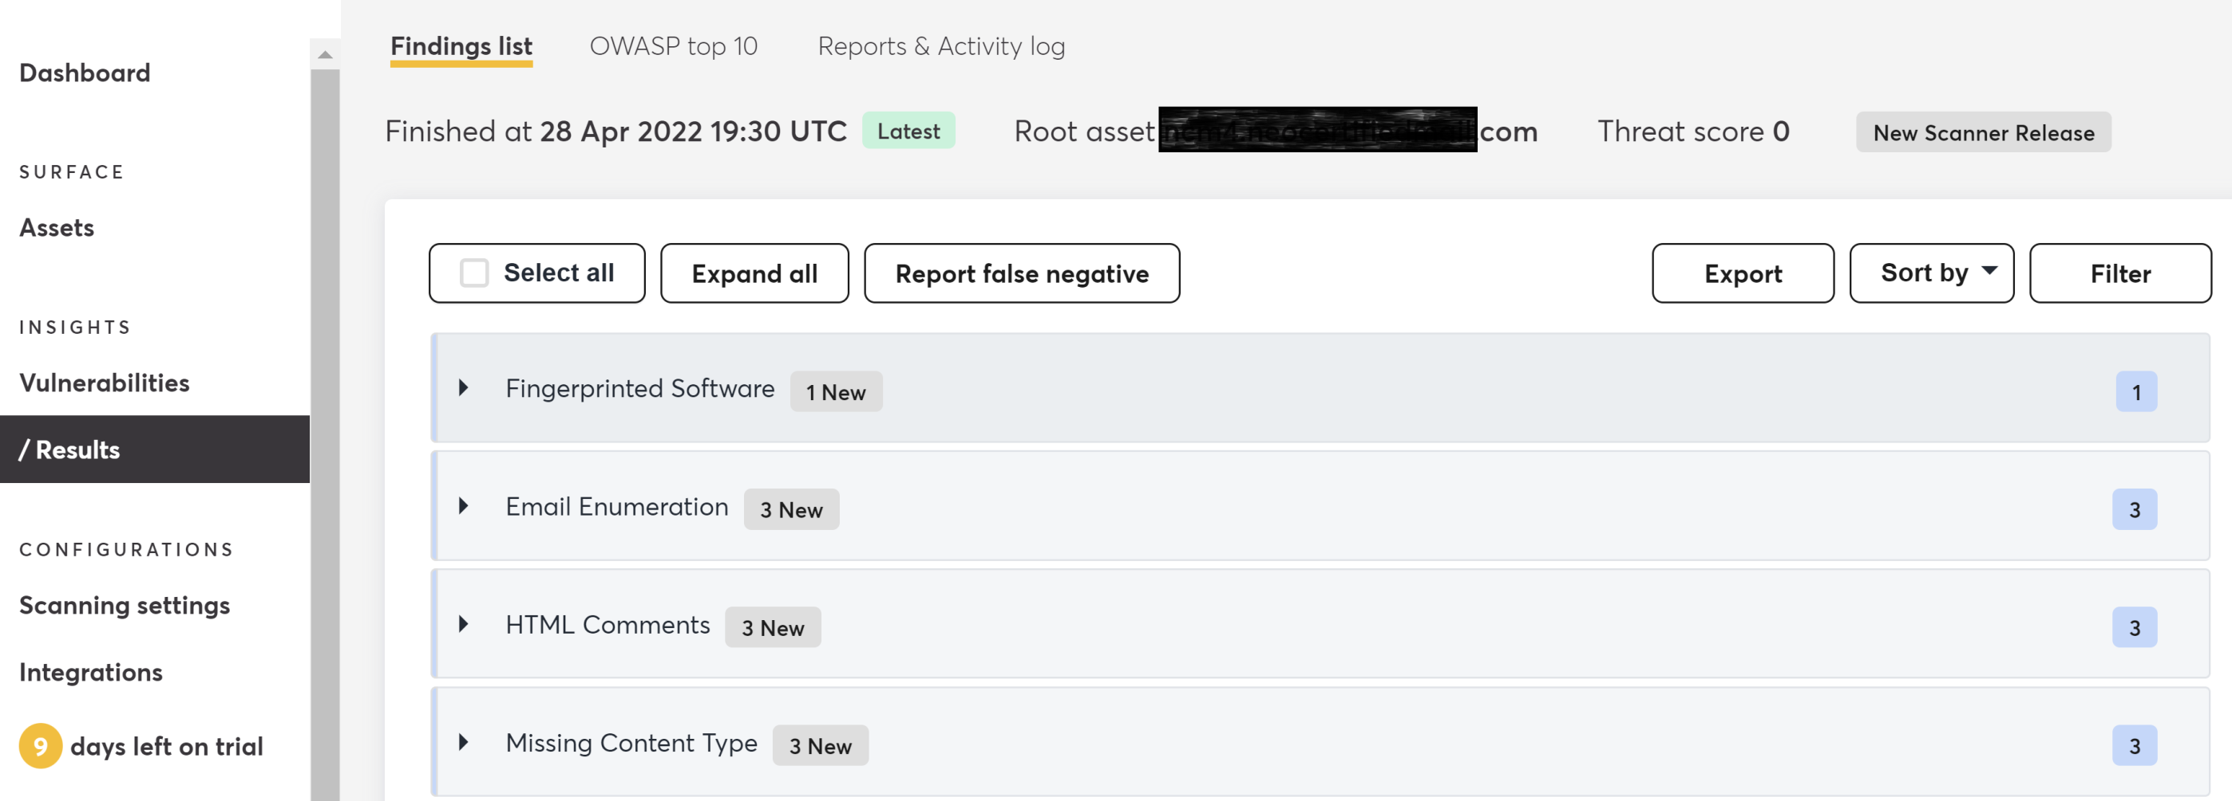
9. Export the Result

Slide 38

Thank You & See You Again

